Slide 1
Automated Scientific Knowledge Extraction March 31st, 2020 PI Meeting AMIDOL
Eric Davis, Alec Theriault, Ryan Wright
https://github.com/GaloisInc/AMIDOL/
This research was supported by the ASKE program under
DARPA-PA-18-02-AIE-FP-039

Slide 2
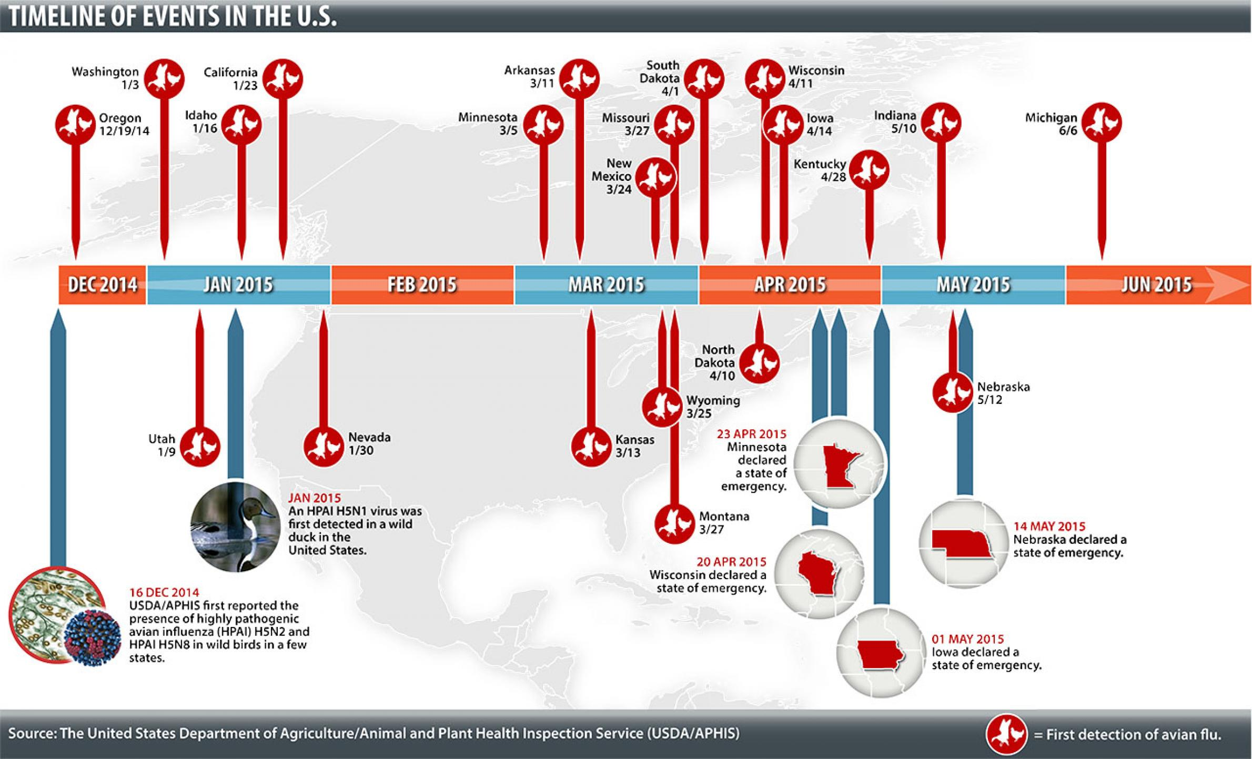
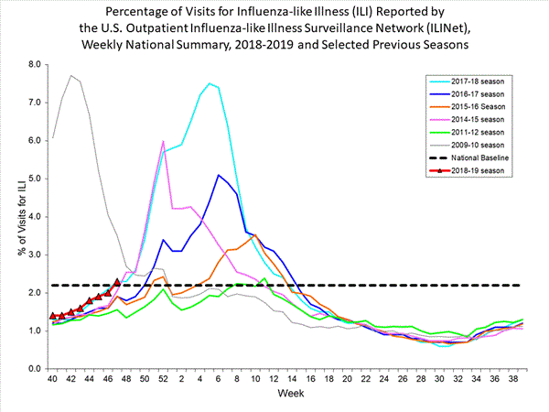
Modeling and Crisis Response: The Ideal
Domain experts capable of agile, performable, and high confidence modeling in response to crisis.
Leverage models to make decisions on actions, policy, with continuous improvement and feedback to improve outcomes.

Slide 3
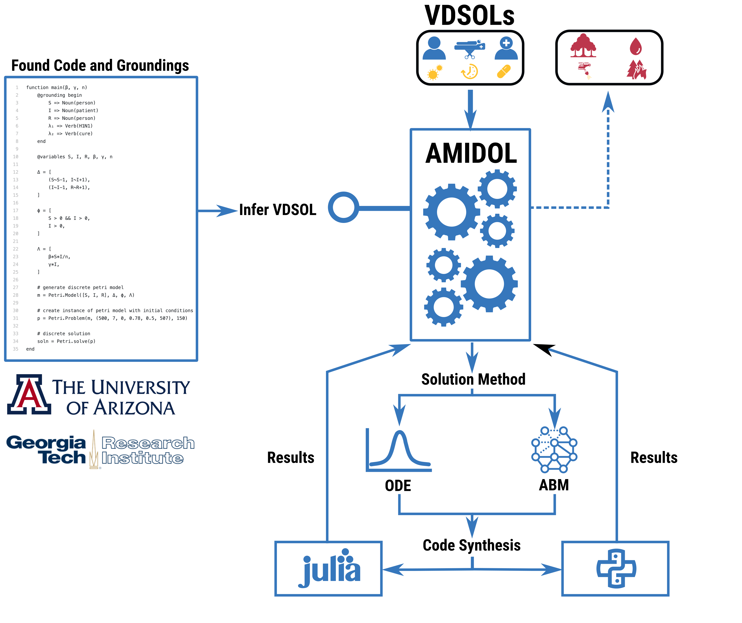
Modeling and Crisis Response: The Reality
We’re witnessing the failure of modeling and crisis response.
Lack of agility
Lack of compatibility
Broken resources and end points
Low confidence in modeling and results

Slide 4
Why Model During Crisis?
Avoid surprisal
Inform policy
Justify policy

Slide 5
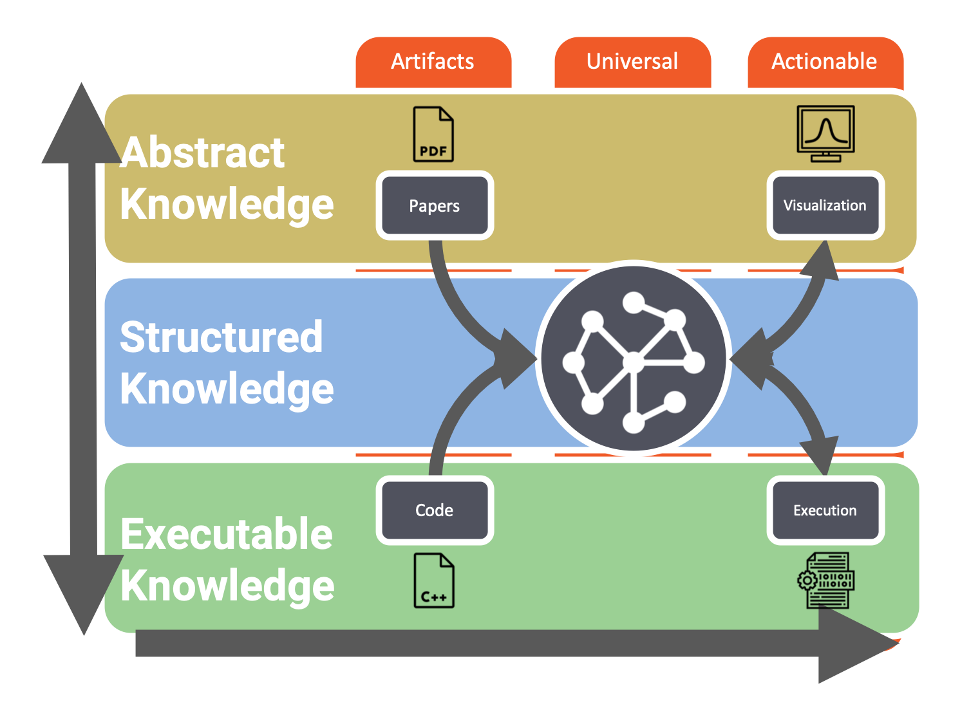
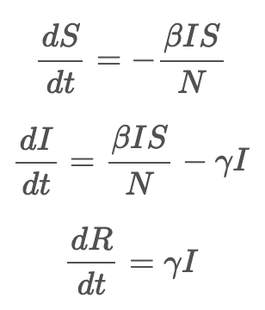

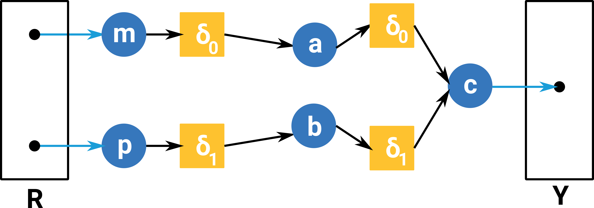
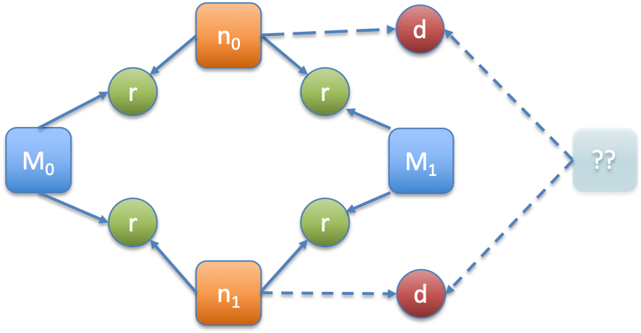
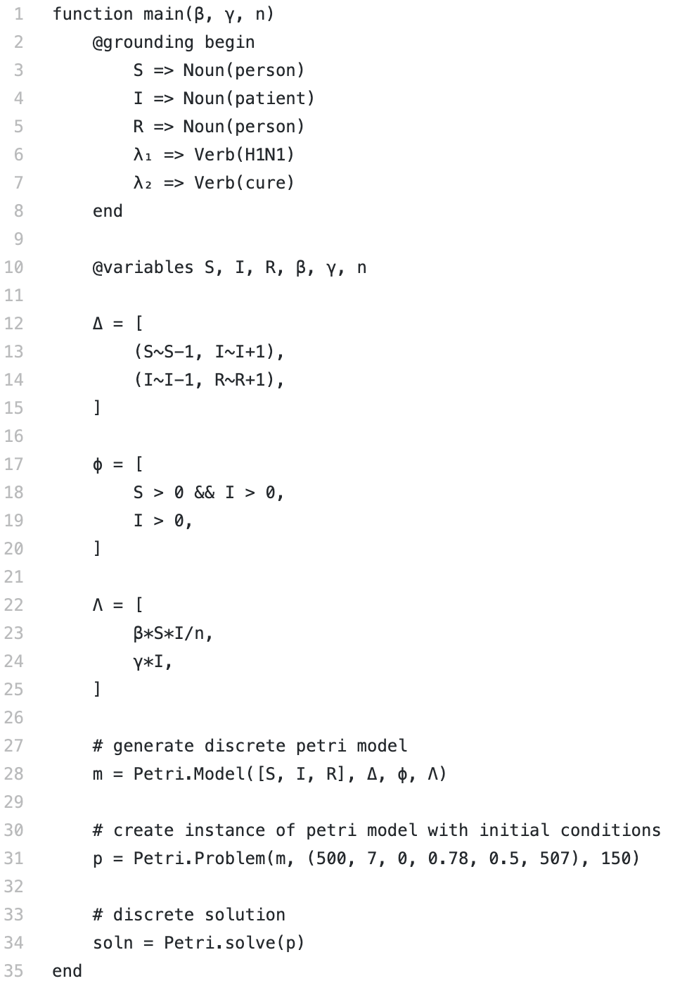


AMIDOL Modeling Stack

Slide 6
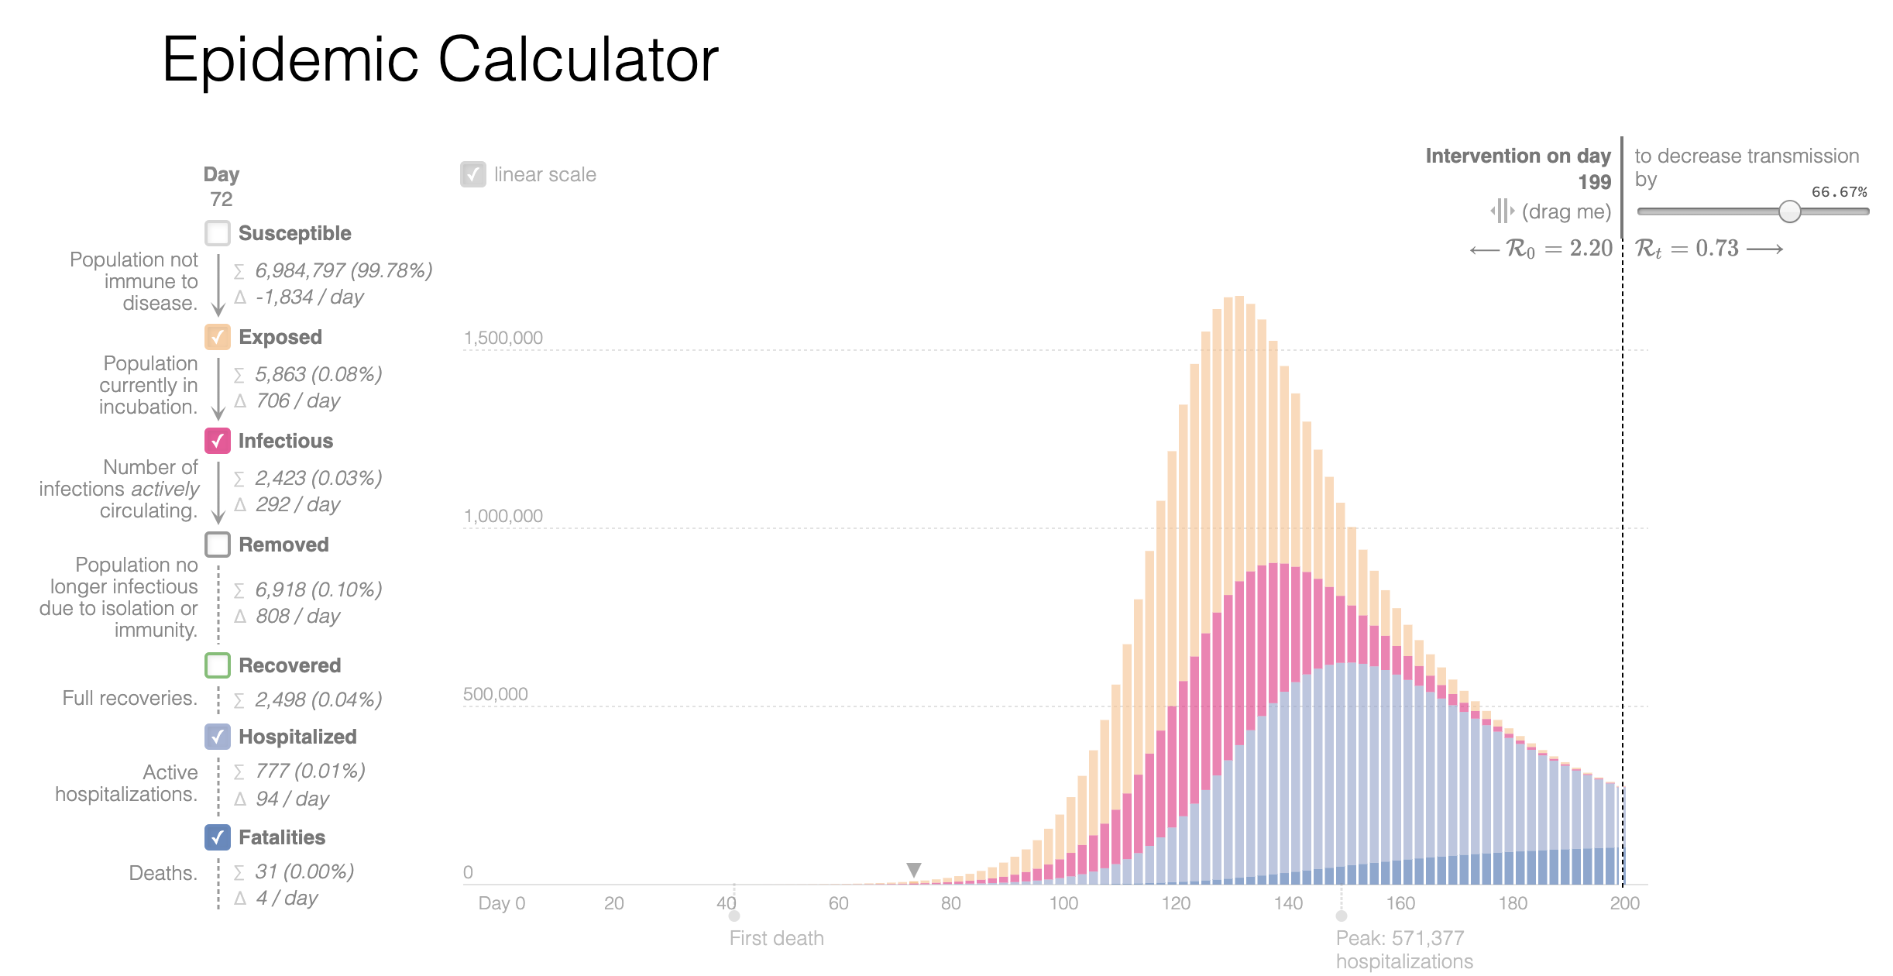
Rapid Model Validation with AMIDOL
Problem: Leveraging Found Models for COVID-19 Modeling
Model isn’t directly executable
Model isn’t “shovel ready” for new analysis
Adapting the model takes an expert.

Slide 7
Rapid Model Validation with AMIDOL
Solution: AMIDOL can be used to rapidly build, validate, and export models for domain experts and policy makers.
High confidence models.
Adapted for local concerns.
Low effort model development, validation, and code synthesis.

Slide 8
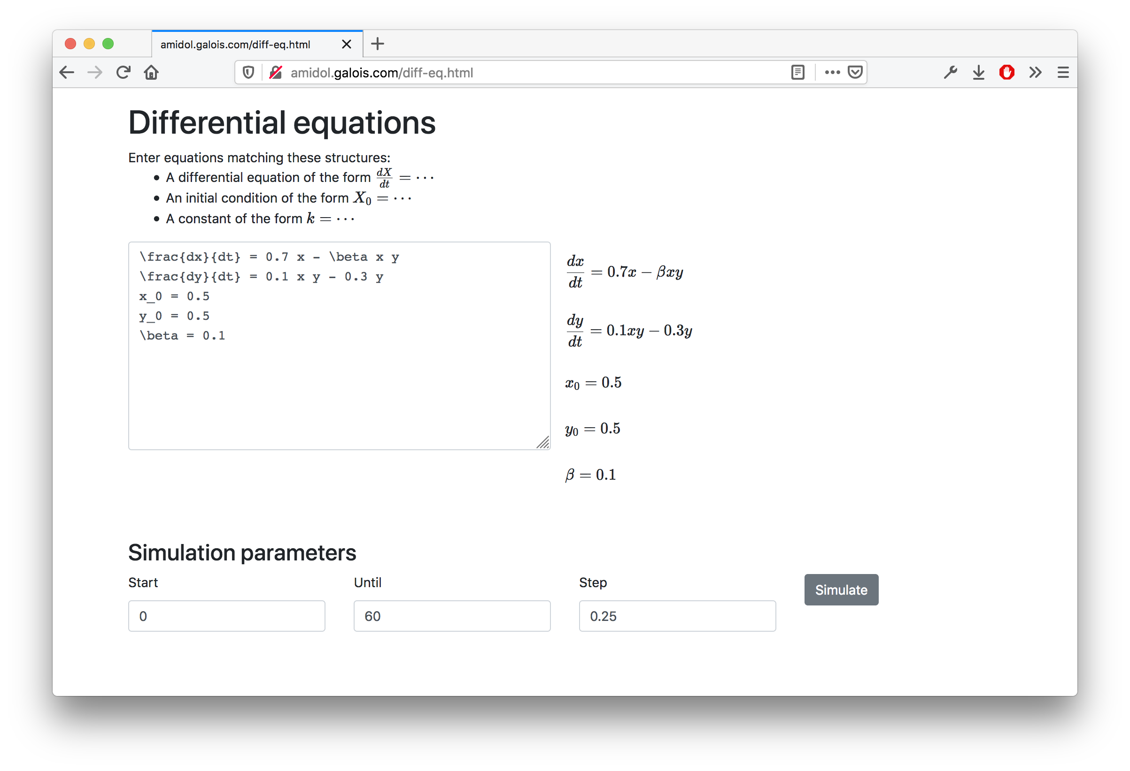
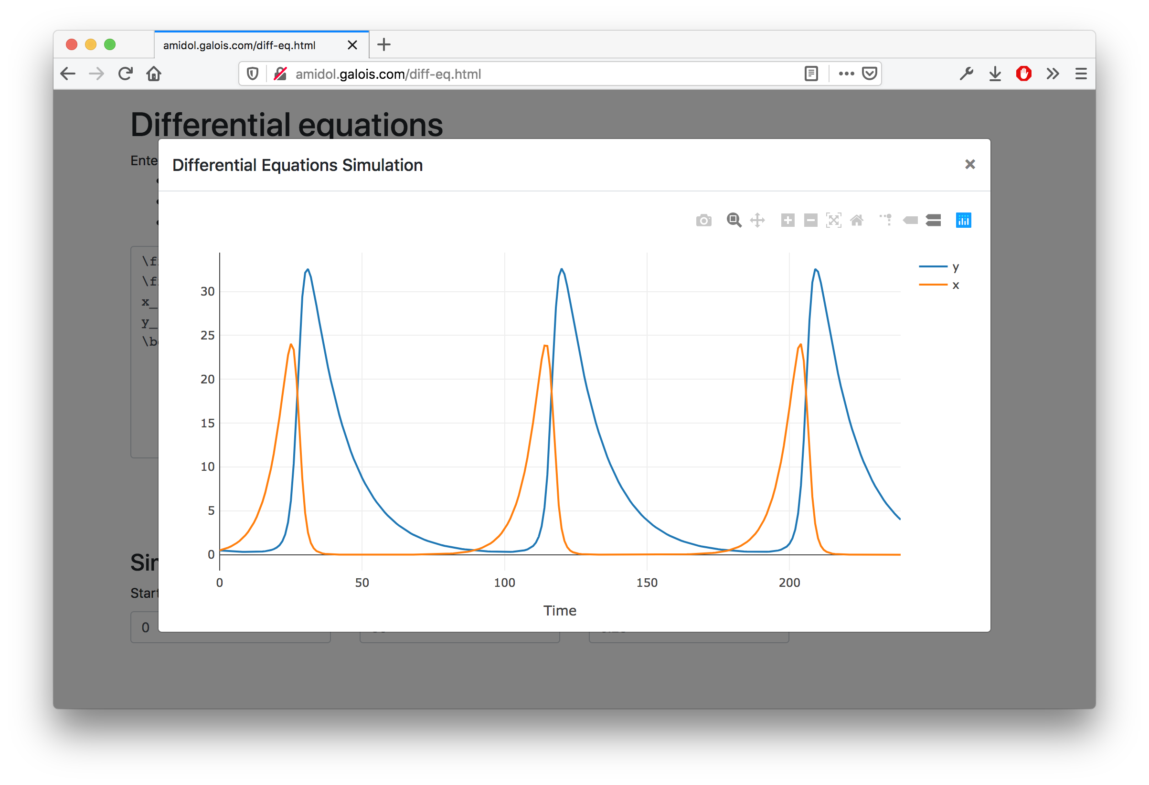
VDSOL Improvements – Differential Equations
Further extended VDSOLs to support equations.
Users can input custom equations into AMIDOL representing:
Initial conditions
Constants
Differential equations
Can read differential equations from LaTeX source.
Represents an entirely new type of VDSOL, showing the flexibility of languages AMIDOL can support.

Slide 9
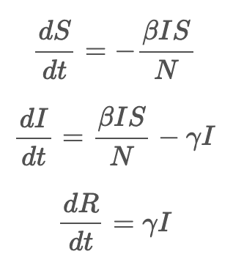
VDSOL Improvements – Differential Equations
Identifying process algebraic interpretations of differential equations.

Slide 10
VDSOL Improvements – Differential Equations
Identifying process algebraic interpretations of differential equations.
State variable (S)

Slide 11
VDSOL Improvements – Differential Equations
Identifying process algebraic interpretations of differential equations.
State variable (S,I)

Slide 12
VDSOL Improvements – Differential Equations
Identifying process algebraic interpretations of differential equations.
State variable (S,I,R)

Slide 13
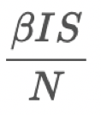
VDSOL Improvements – Differential Equations
Identifying process algebraic interpretations of differential equations.
State variable (S,I,R)
Event S → I (. )

Slide 14
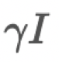
VDSOL Improvements – Differential Equations
Identifying process algebraic interpretations of differential equations.
State variable (S,I,R)
Event S → I (. )
Event I → R (. )

Slide 15
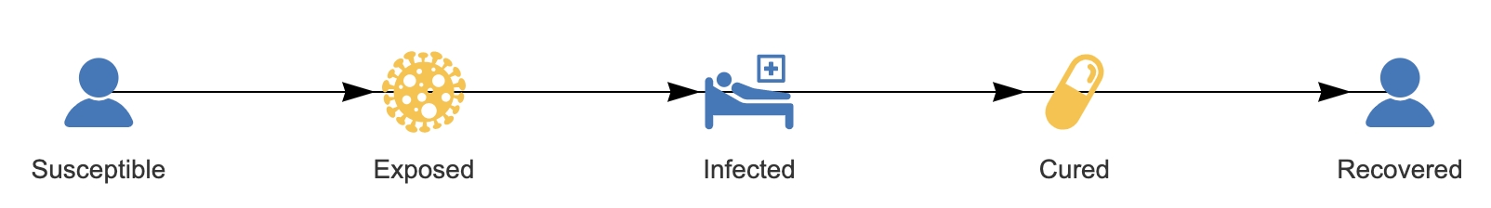
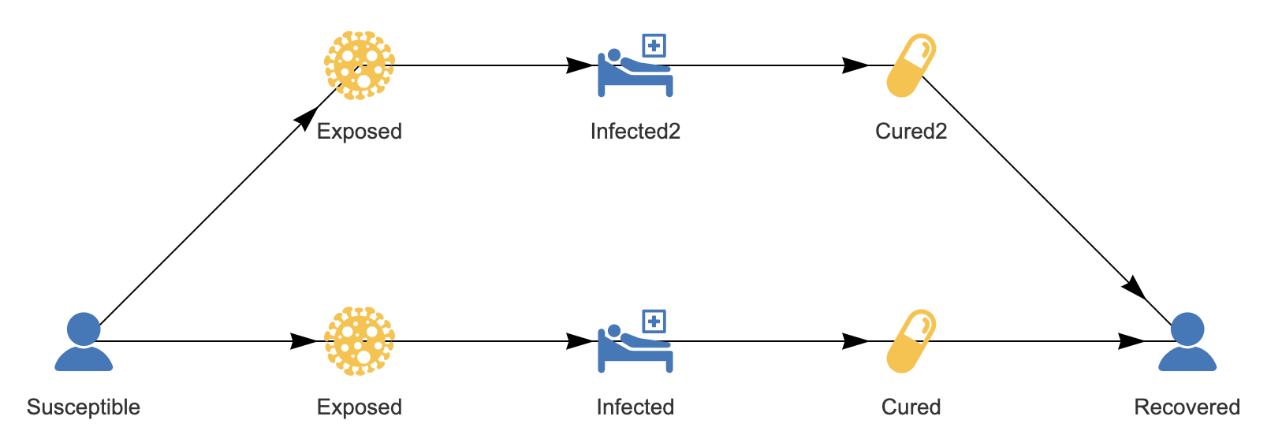
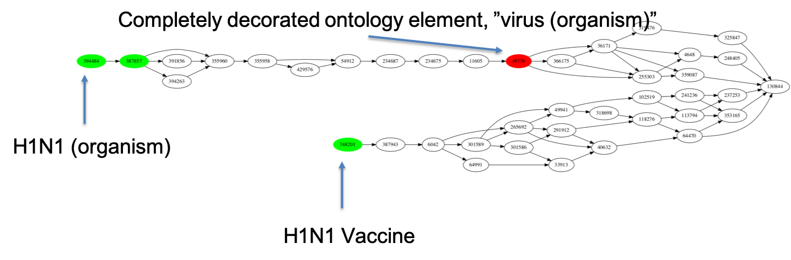
Knowledge Discovery and Curation
AMIDOL models are stored as:
VDSOLs: Abstract Knowledge Layer formulations to allow scientists to interact directly.
Process Algebras: Structured Knowledge Layer models in universal forms for curation and transformation.
AMIDOL allows models and formulations to be connected to domain-specific ontologies, curating knowledge and relating it to semantic content.

Slide 16
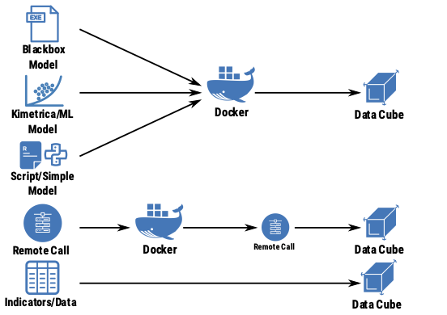
AMIDOL as a “Model Factory”
Build models and input/output abstractions rapidly in AMIDOL.
Export and container-ize in a model ecosystem for rapid COVID modeling.
Also import data as first class models.

Slide 17
Data as First Class Models

Slide 18
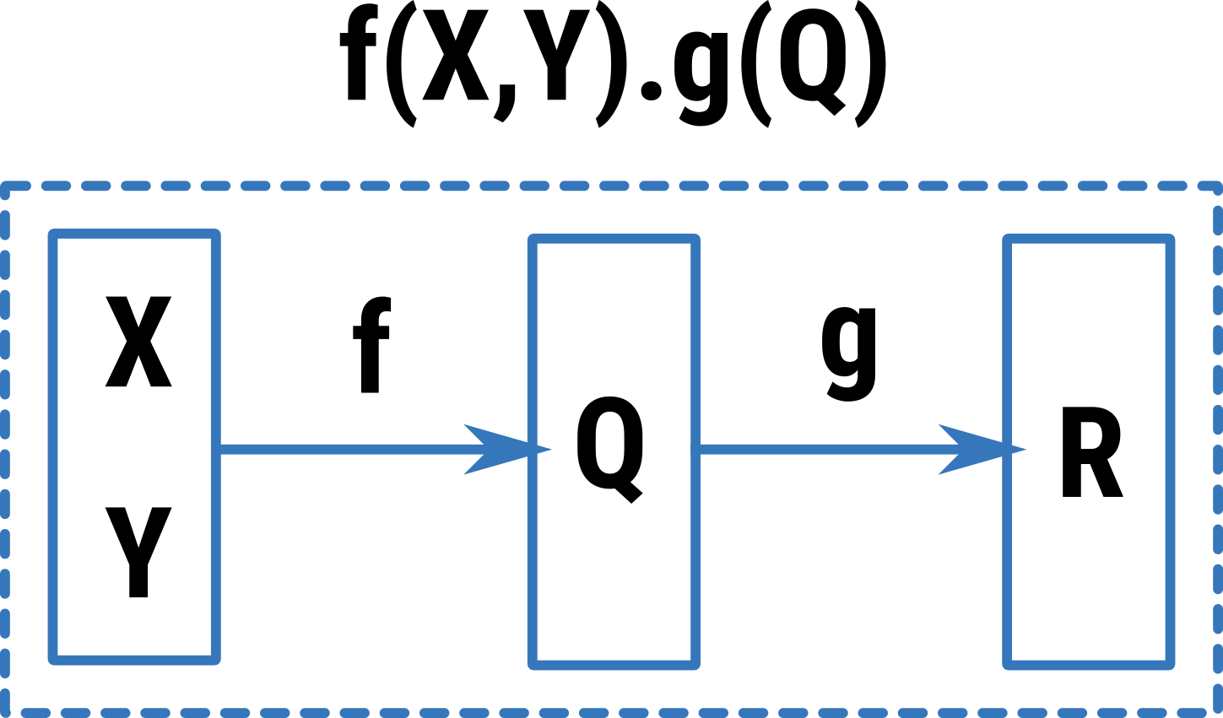
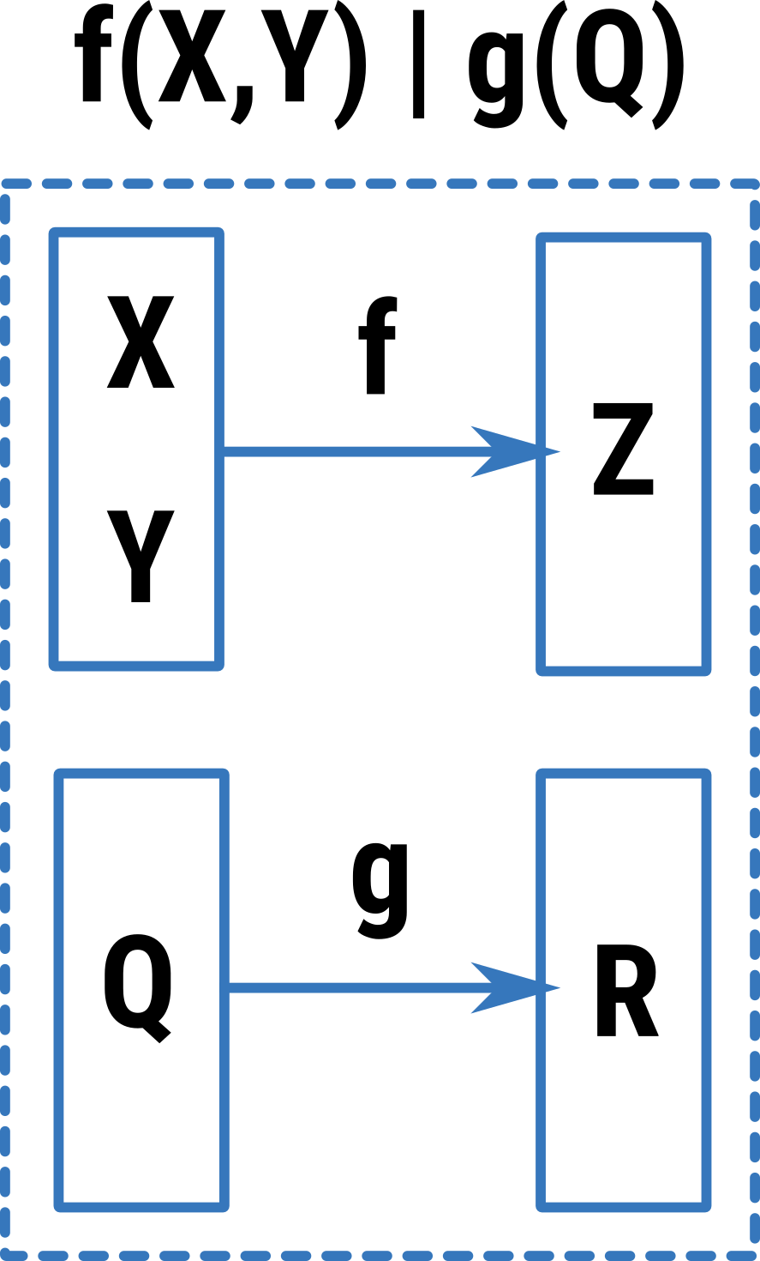
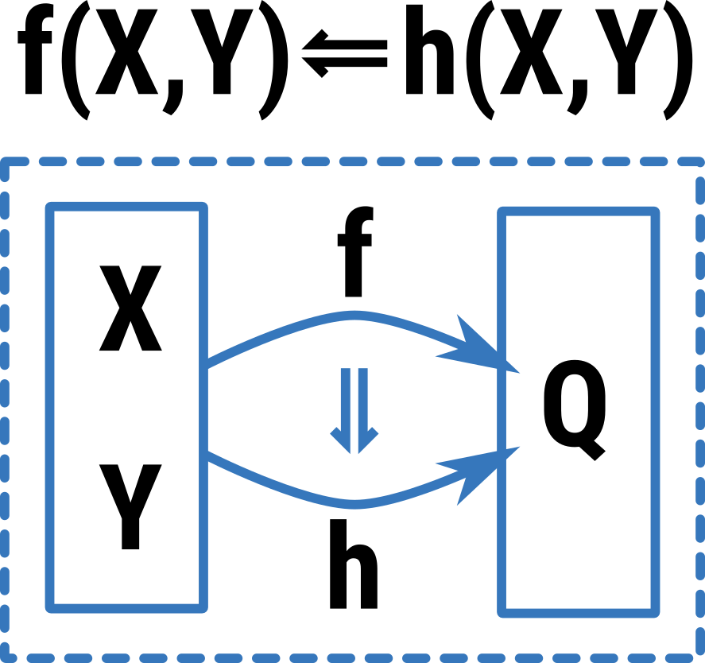
What can we do with Data as a Model?
Composition!
AMIDOL Model Algebra Allows the use of composition to form “new” models from atomic components.

Slide 19
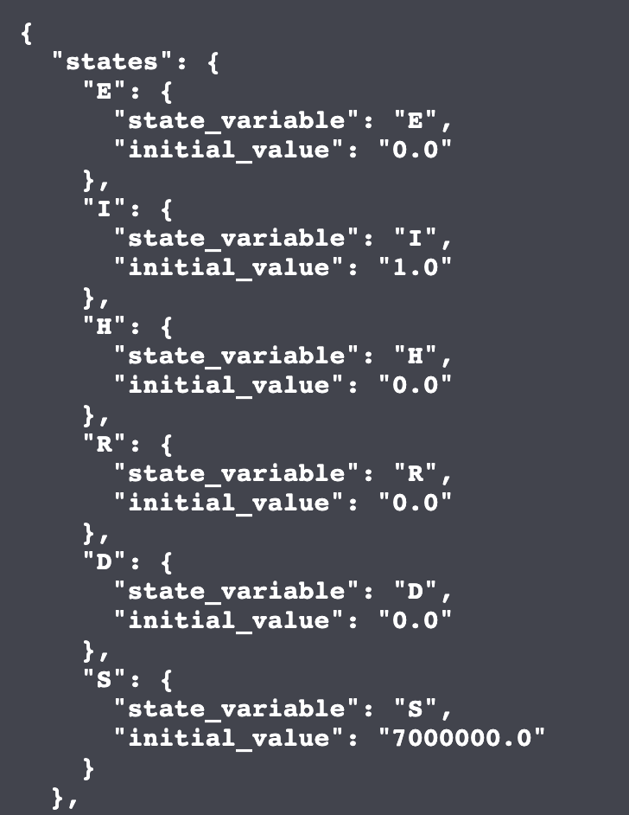
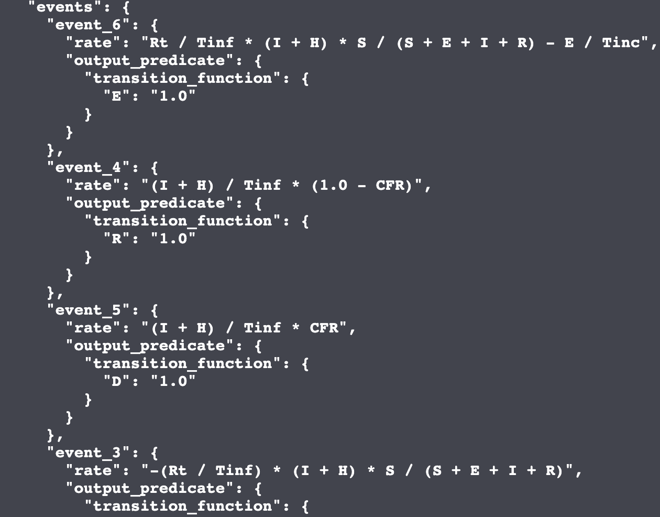
What can we do with Data as a Model?
Composition!
AMIDOL Model Algebra Allows the use of composition to form “new” models from atomic components.
Model algebra ensures that composing models results in a new model.

Slide 20
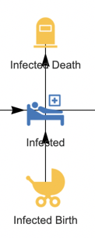
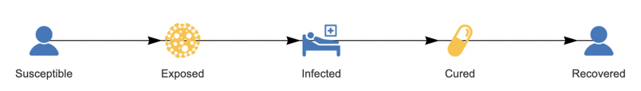
Allows Compositional Modeling
Vital dynamic model:
v(P)
SIR model:
f(S,I,R)
(v(P) | v(P) | v(P)).f(S,I,R)
Allows researchers to design models piece wise, reuse work, and share knowledge.
Resulting models should be translatable to VDSOLs using groundings using our prior developed inference procedures.

Slide 21
Other Types of First Class Models
Data – “Uninteresting models”
But very important for alignment with real world observations.
”Transforms”
Take inputs of one type and produce outputs of another, more compatible type.
Data normalizations, unit transformations, aggregations, disaggregations, etc.
n₀
d
r
r
M₀
M₁
??
r
r
n₁
d

Slide 22
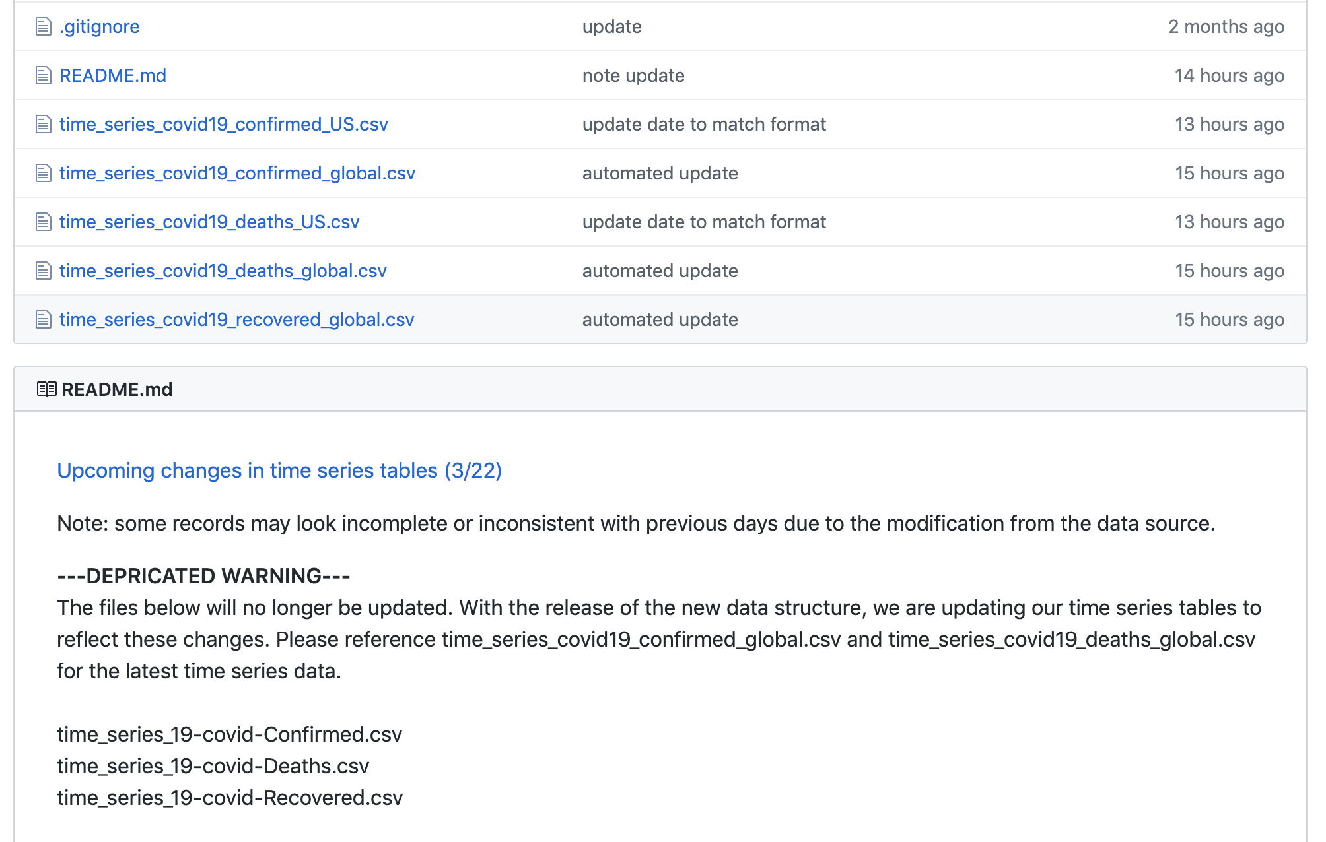
The Importance of Transforms for Agile Response

Slide 23
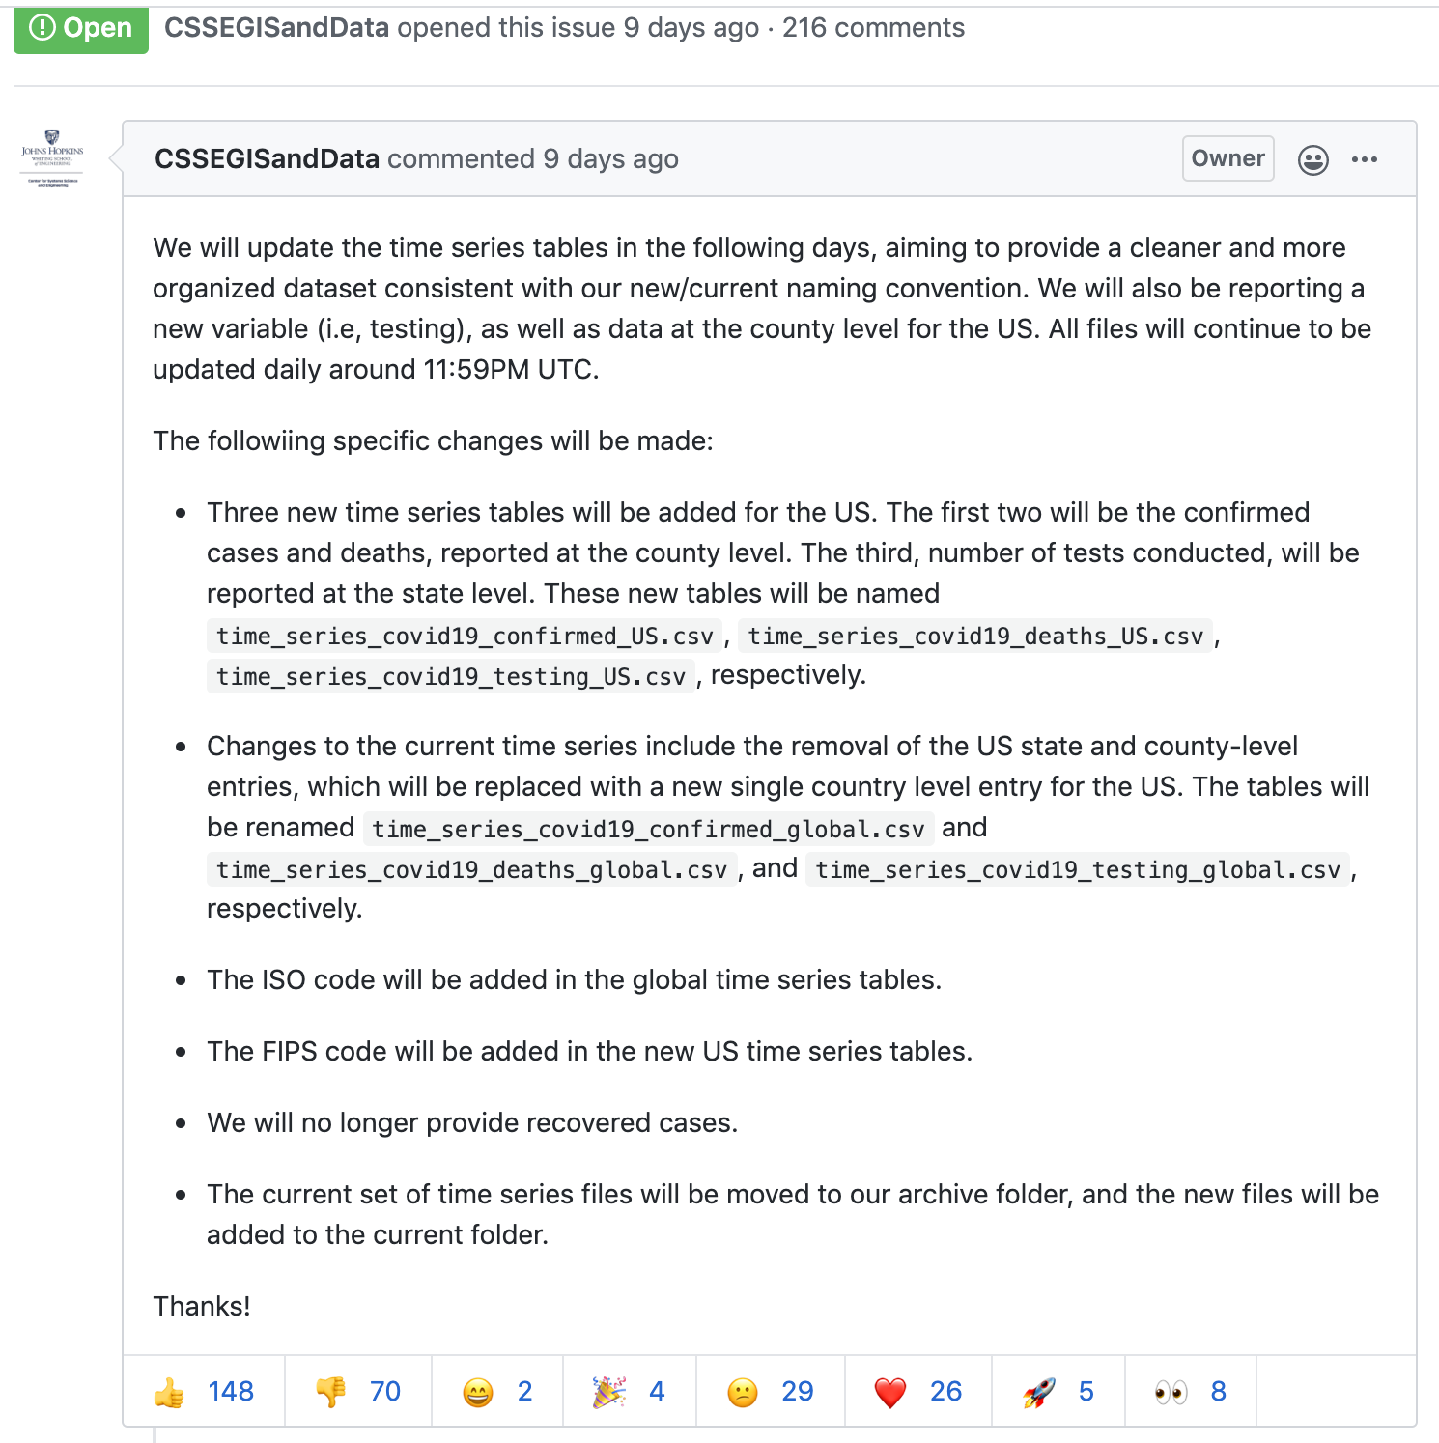
The Importance of Transforms for Agile Response
Adapting data sources with transforms to keep models from breaking.
Modeling as a Service
MaaS (WM) – building model pipelines.
AMIDOL as a model factory can help build these pipelines.
Rapidly debug pipeline failures.
Generate pipeline “patches” in response to changes when modeling during a crisis.

Slide 24
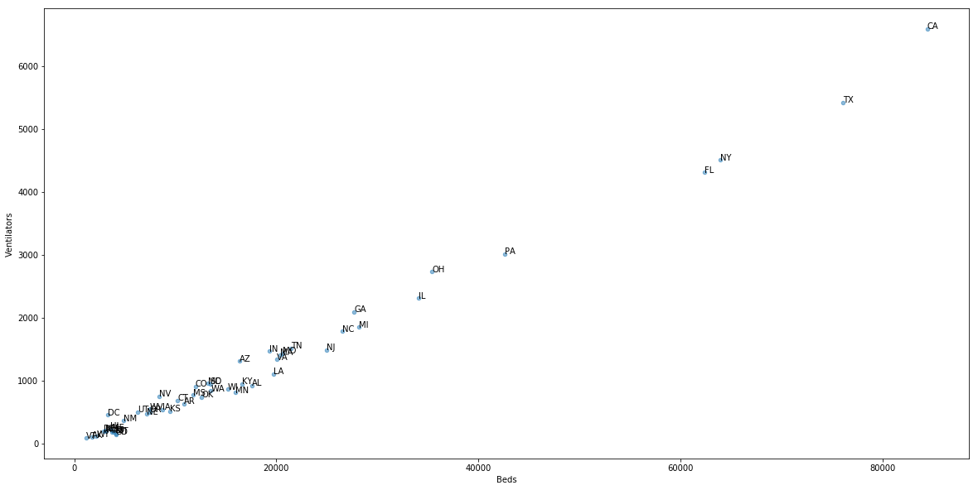
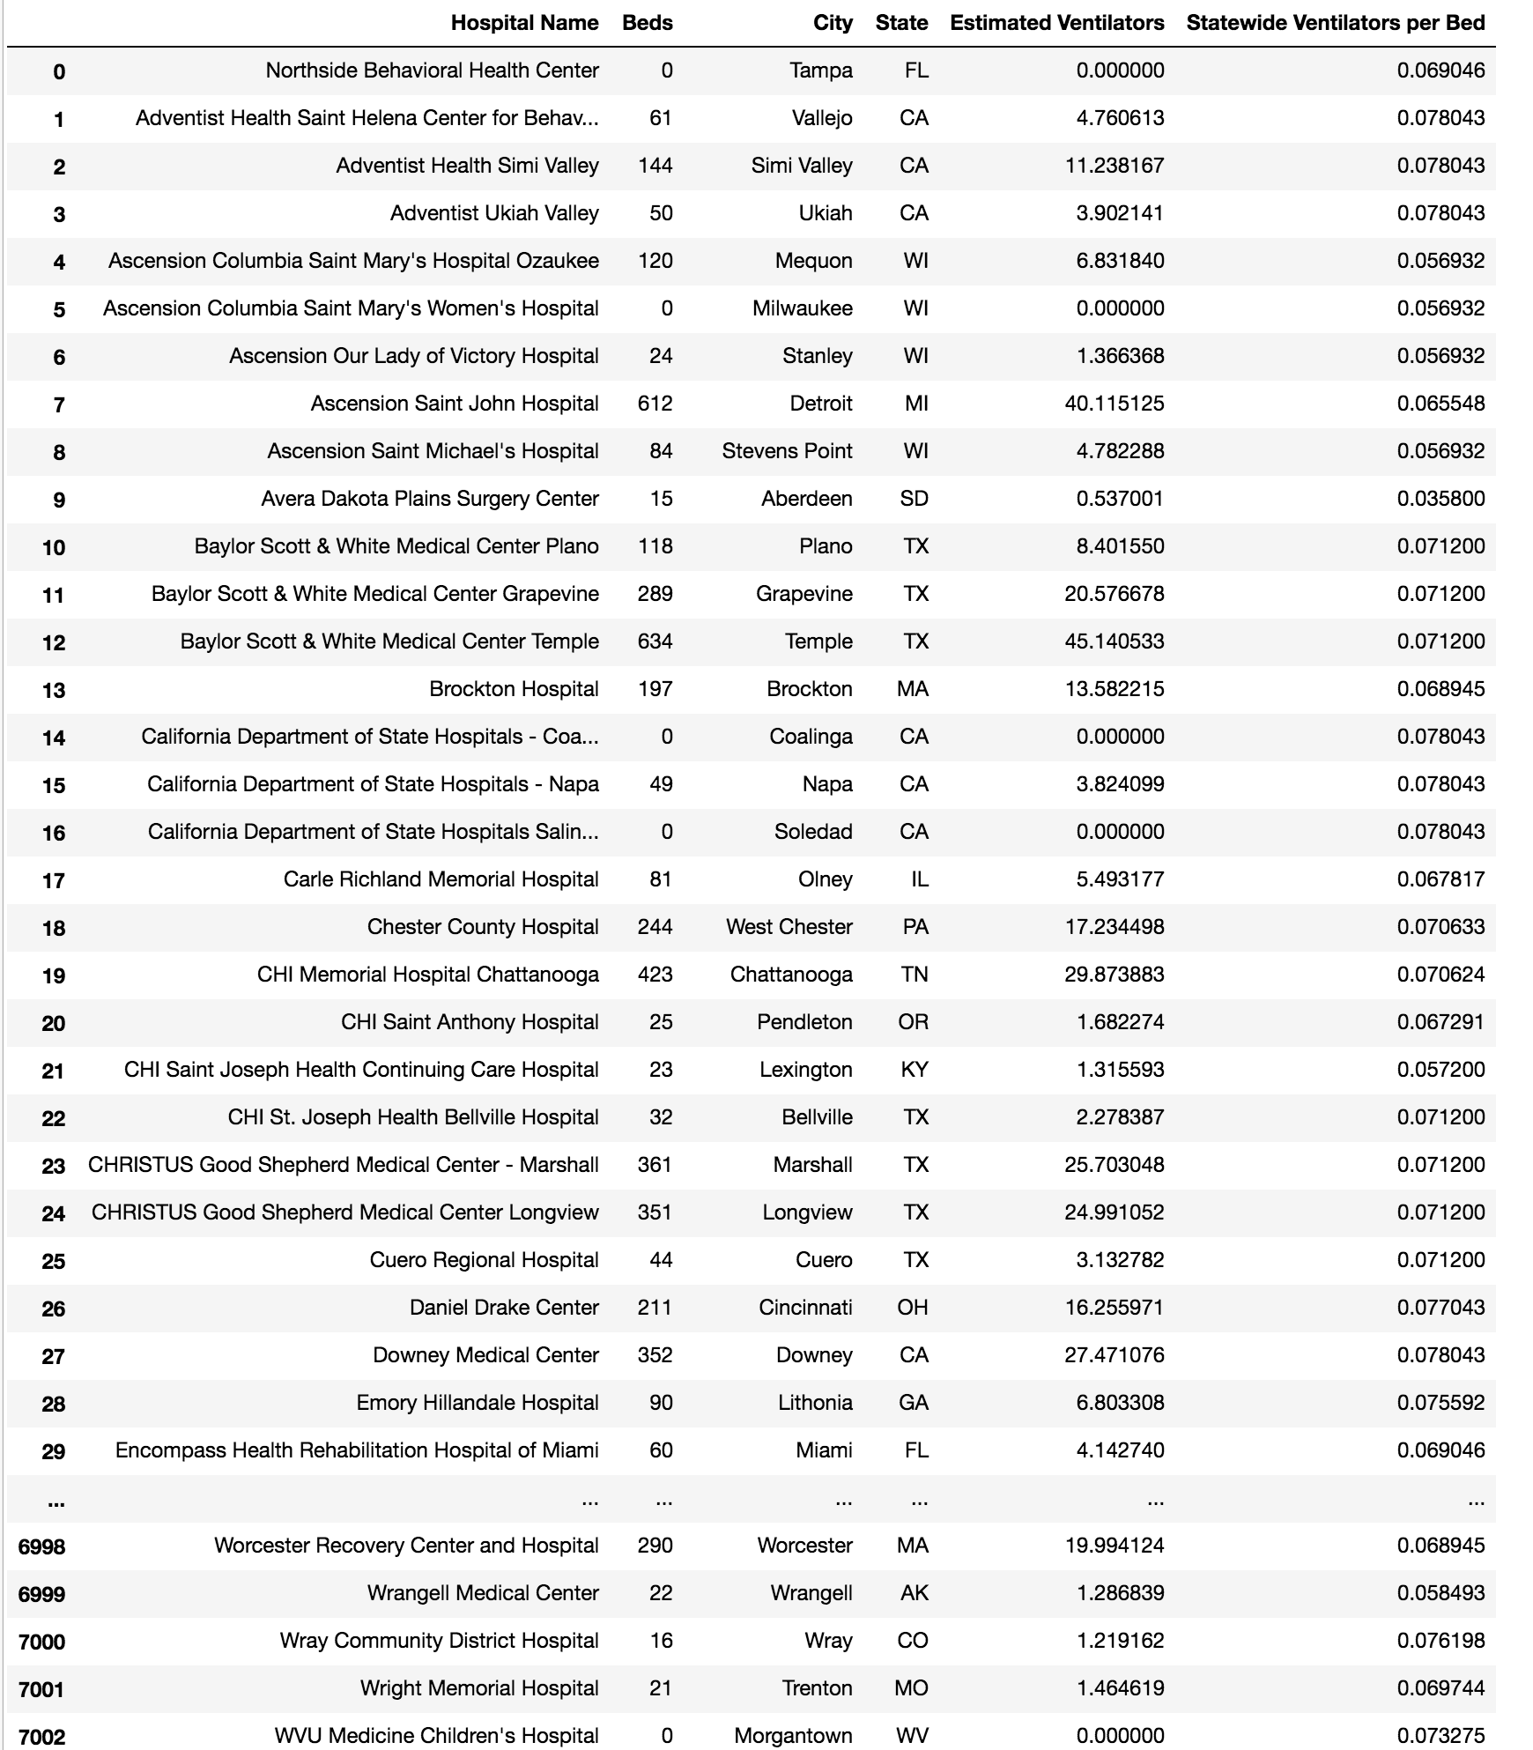
Data Transforms and Models
Use of data as an empirical model to fill in gaps in understanding for interventions and model development.

Slide 25
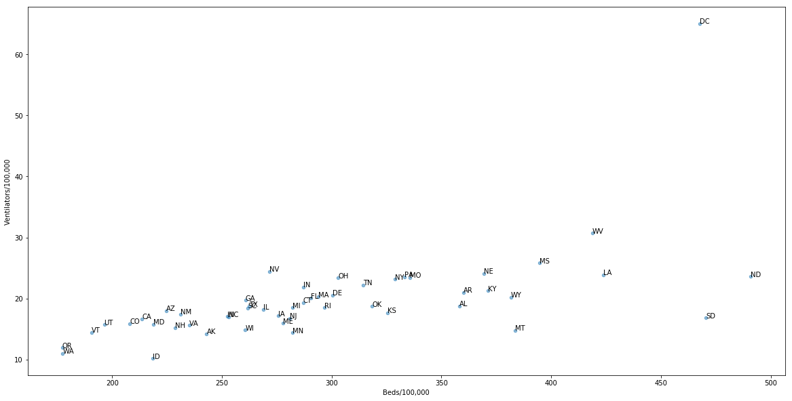
Improved Analysis to Understand Model Impact

Slide 26
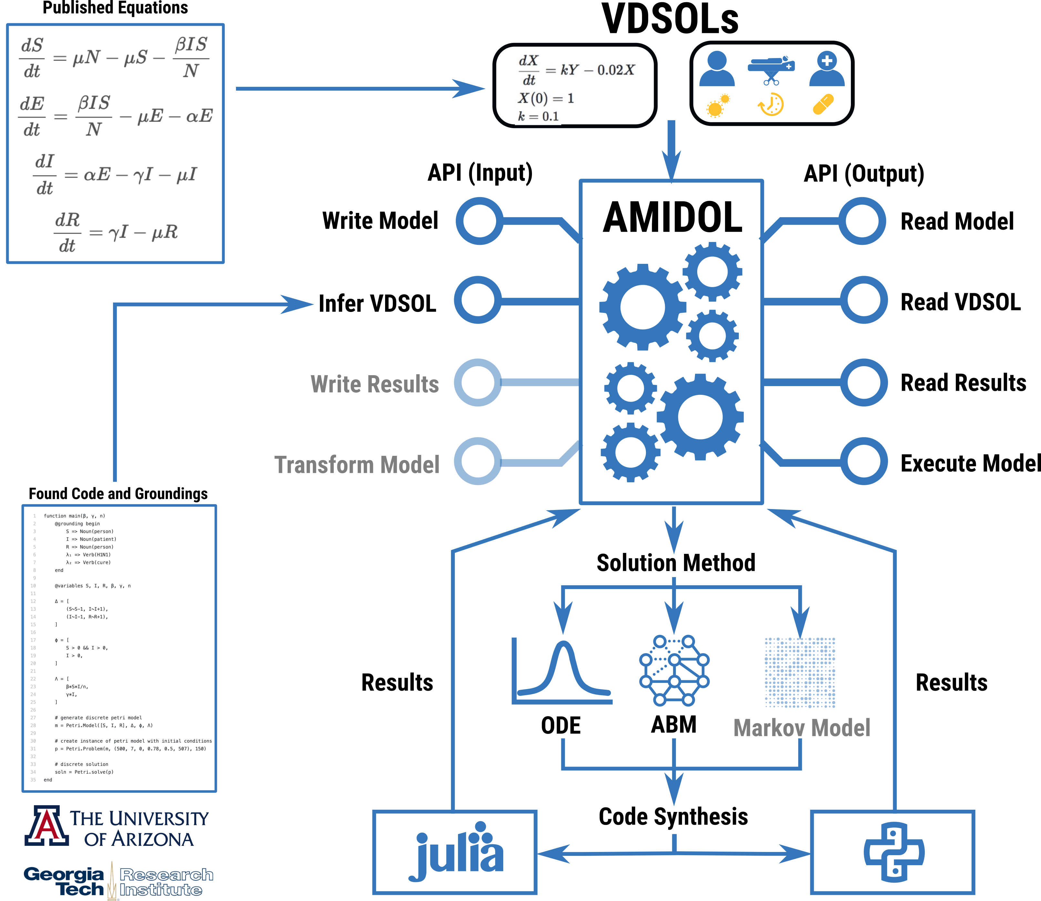
Leveraging AMIDOL for the broader ecosystem
The AMIDOL API
Allows external programs to use AMIDOL as part of an integrated prototype.
Allows AMIDOL to be used as a modeling service.
External programs/services can interact by:
Reading/writing models
Reading/writing/infering VDSOLs
Reading/writing results
Transforming/executing models
Provides a way to engage with users using AMIDOL.
Provides a way to call AMIDOL’s solution logic and compiler/code synthesis engine.

Slide 27
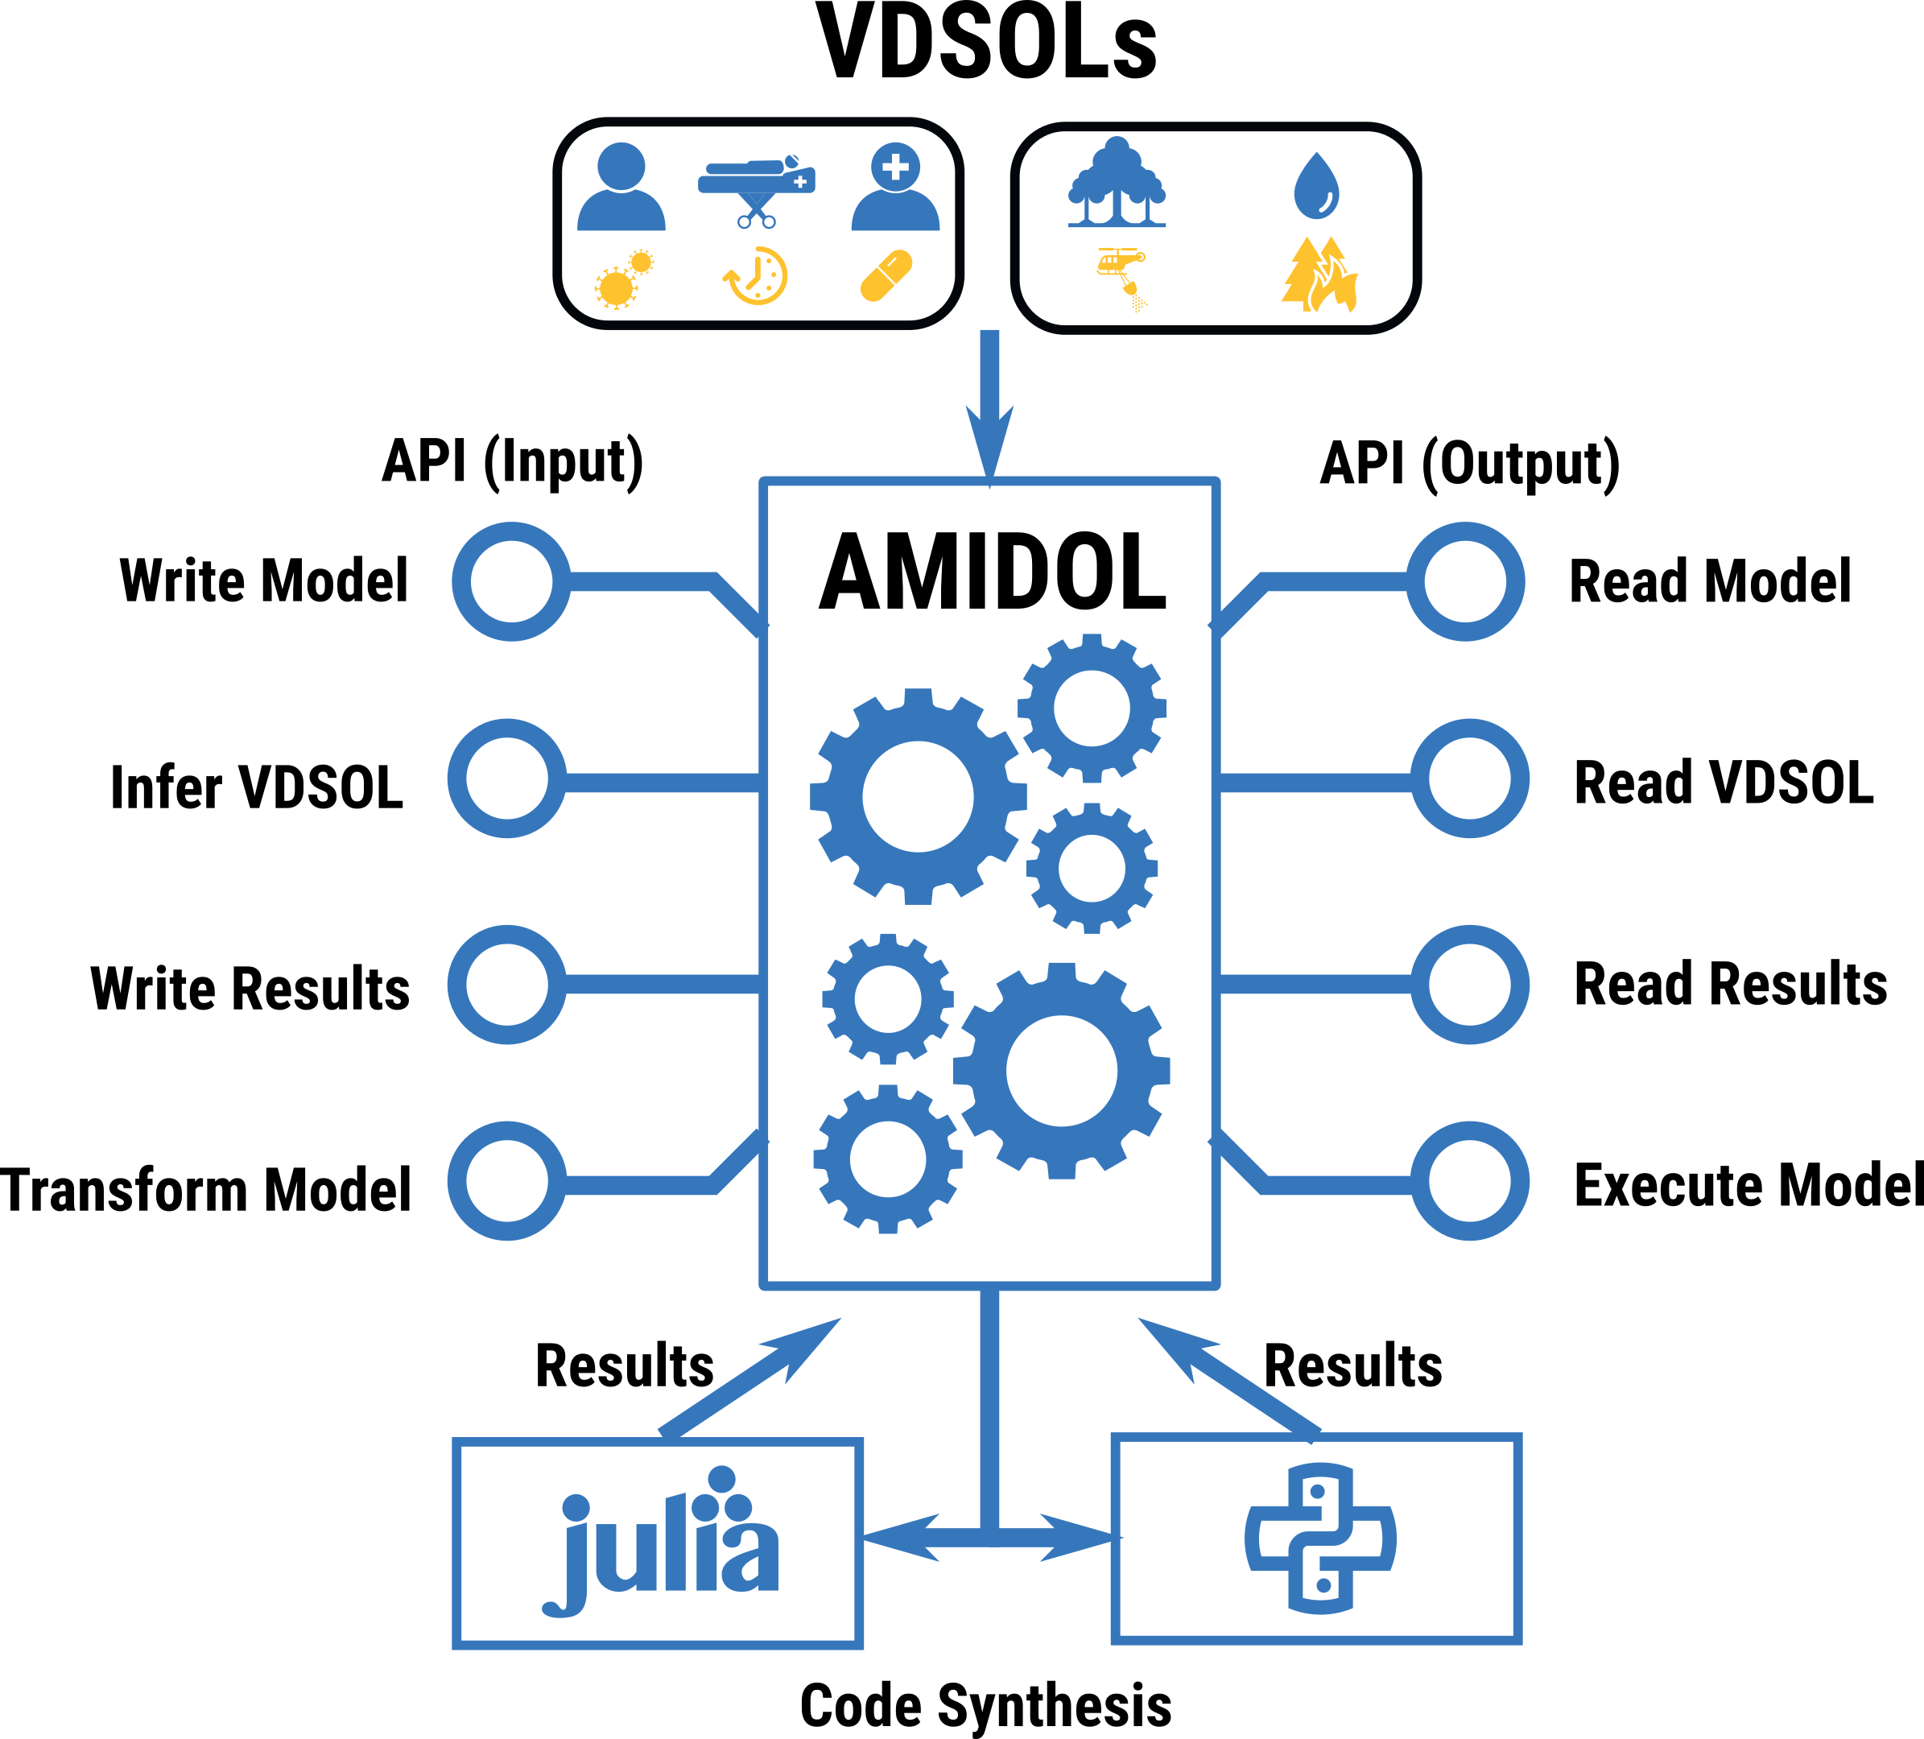
Constructing, Transforming, and Sharing Models
AMIDOL API
AMIDOL API allows for tools/projects to access AMIDOL as a service.

Slide 28
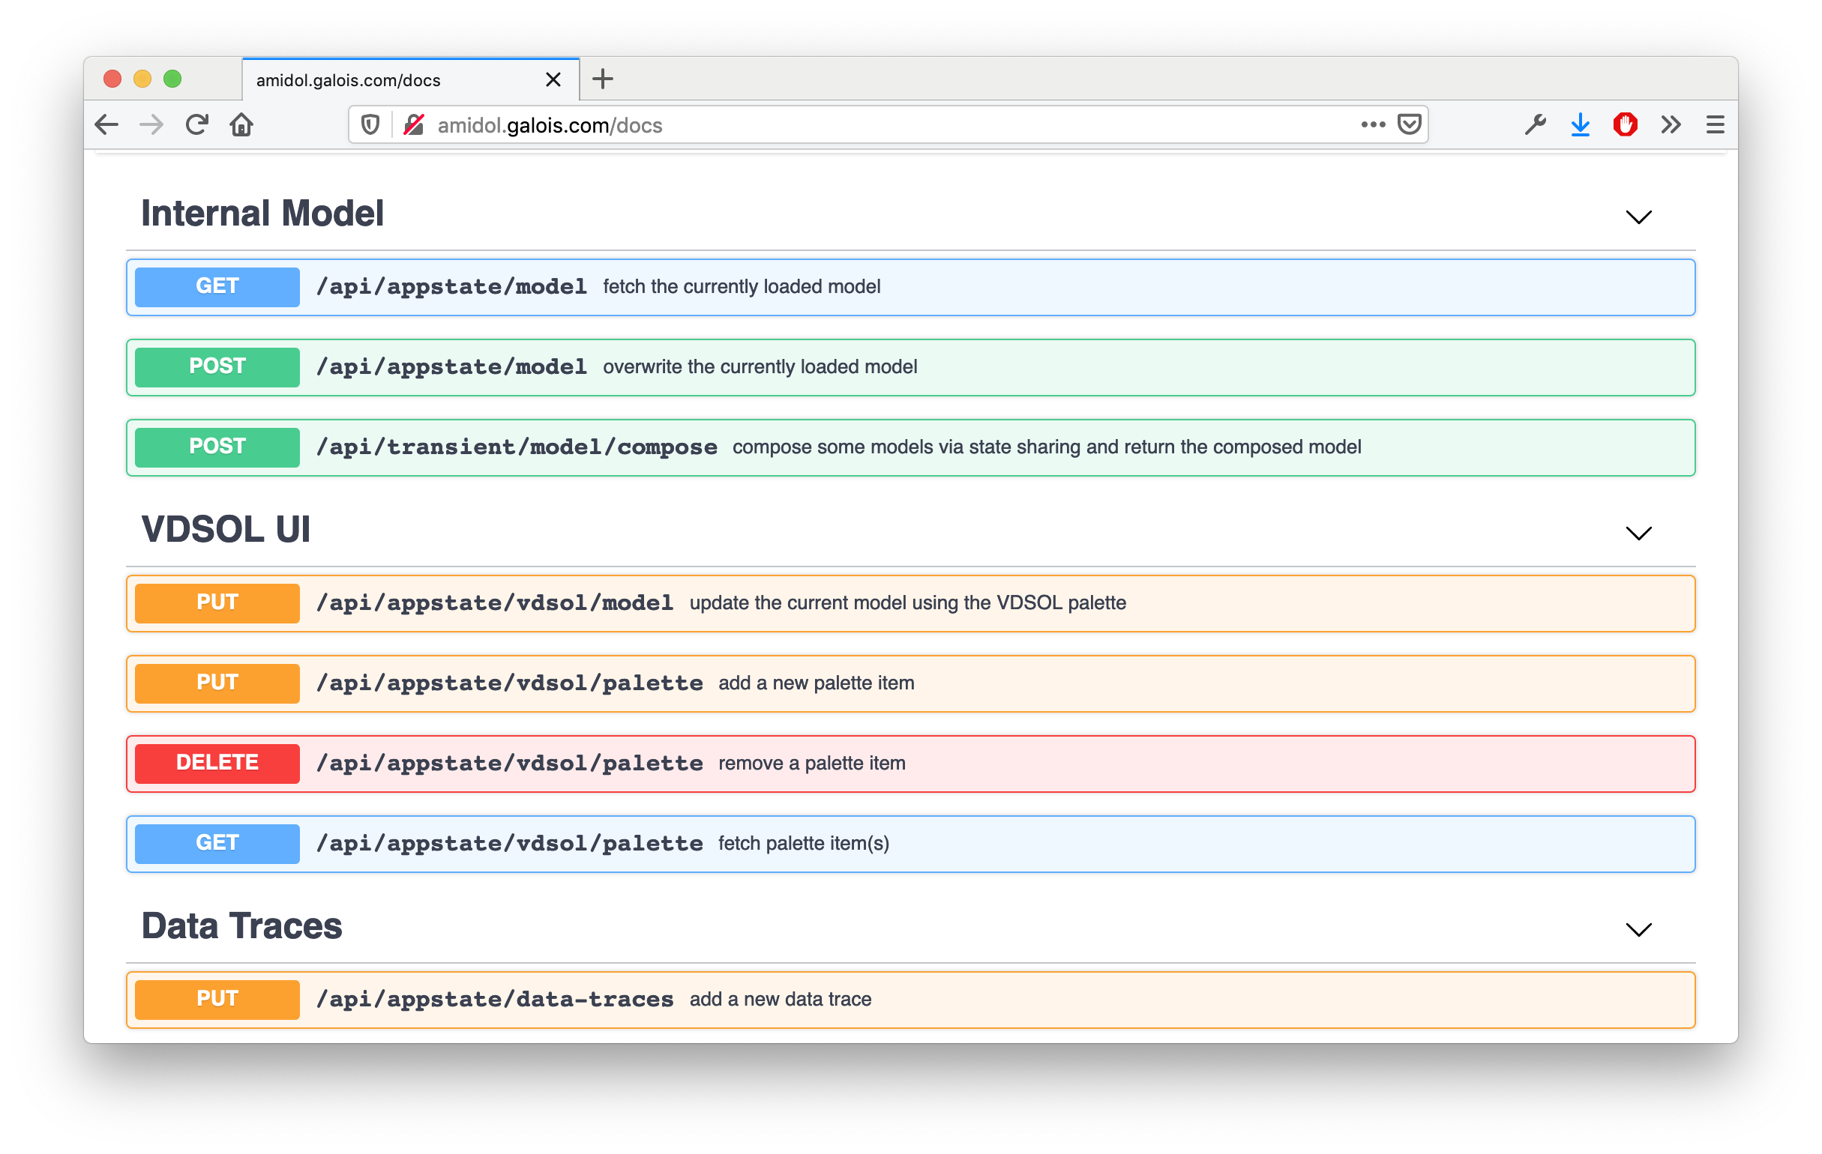
AMIDOL as a Service
OpenAPI Specification
Discoverable endpoints in a human and machine friendly format.
Thoroughly documented endpoint shape (JSON schema, Swagger UI).

Slide 29
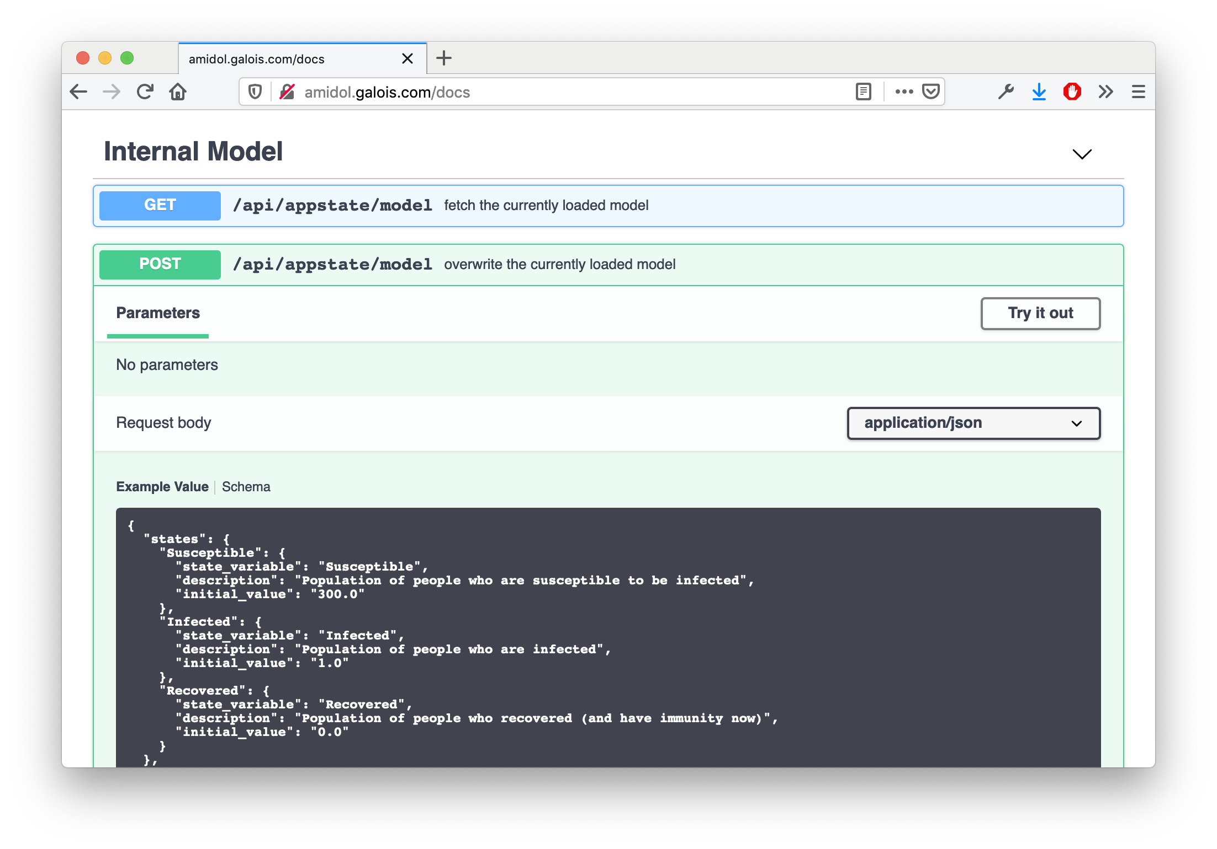
AMIDOL as a Service
Get/modify models built with AMIDOL in its IR representation.
Universal model representation.

Slide 30
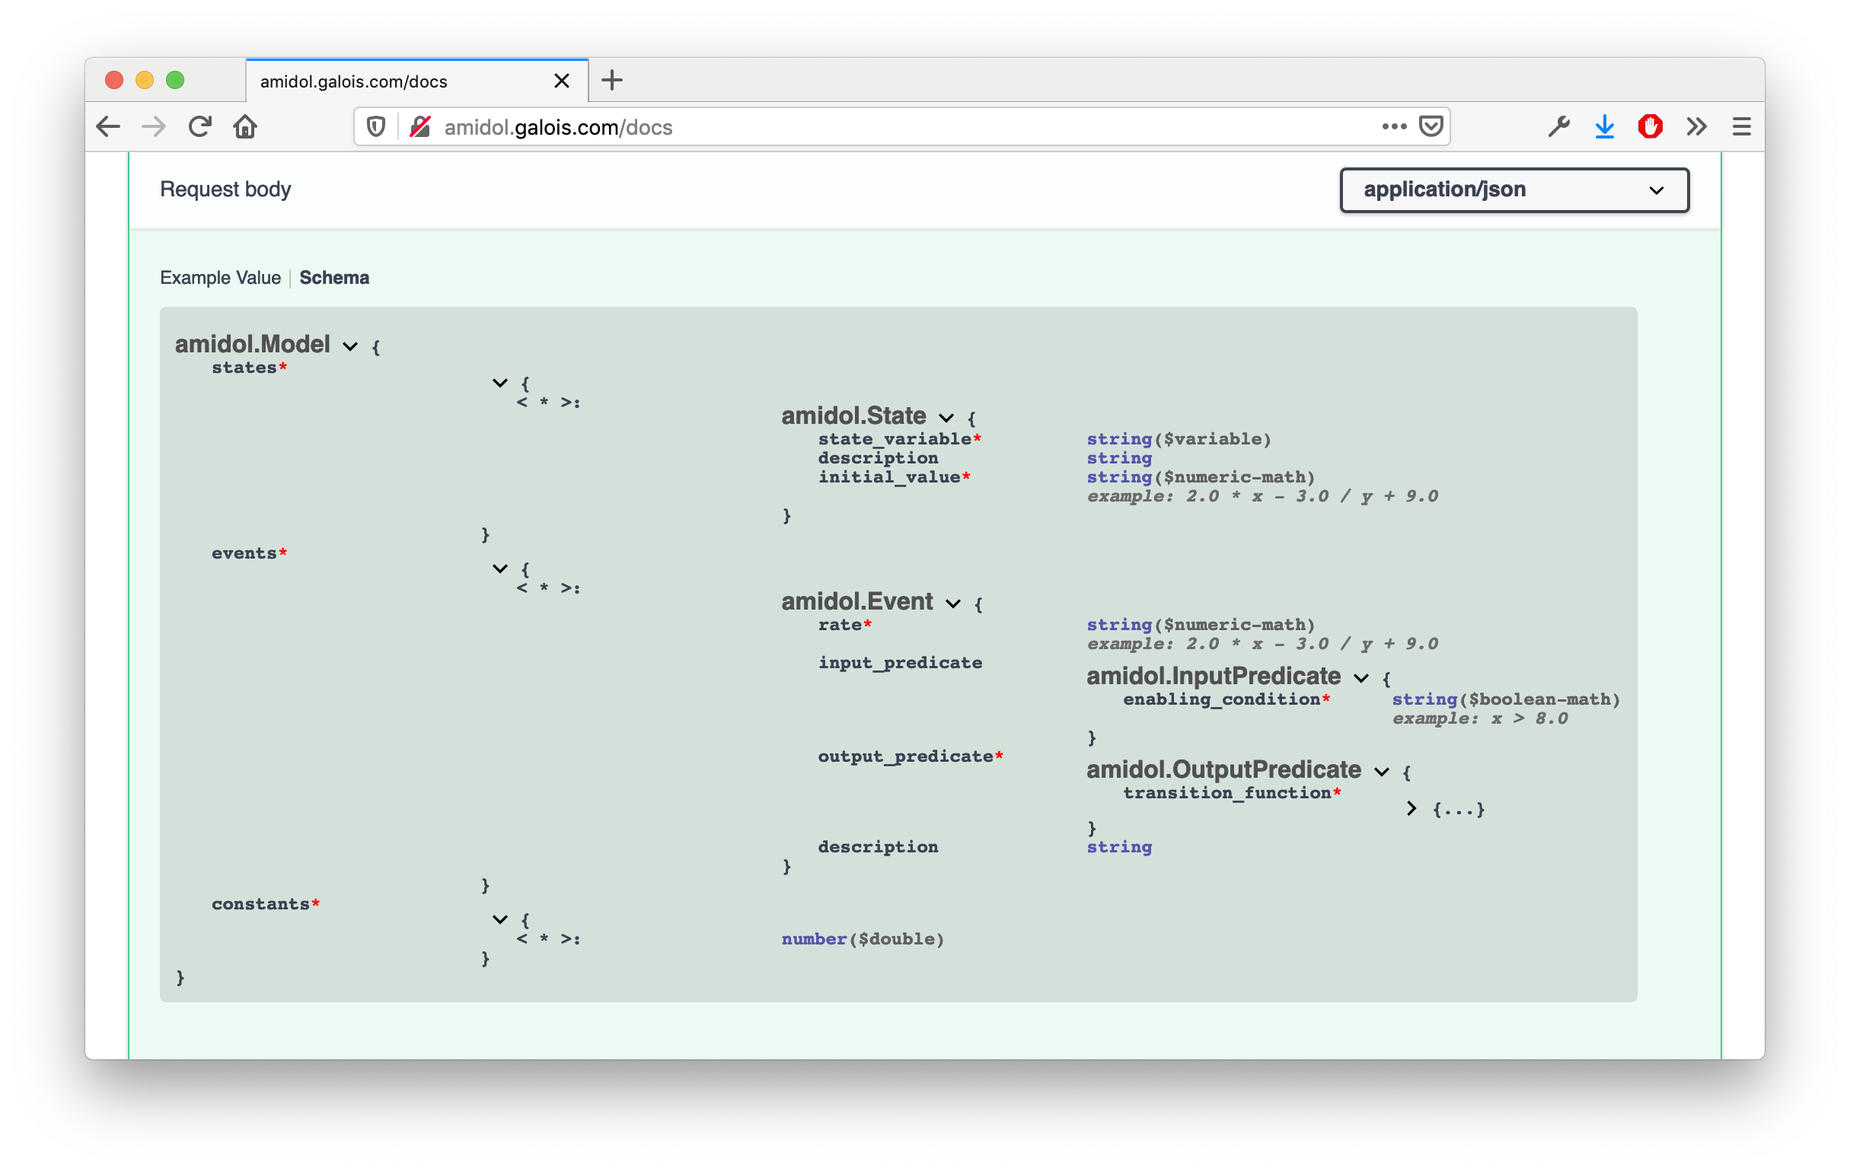
AMIDOL as a Service
OpenAPI also documents the AMIDOL IR, exposing the internals for expert users and to build confidence.

Slide 31
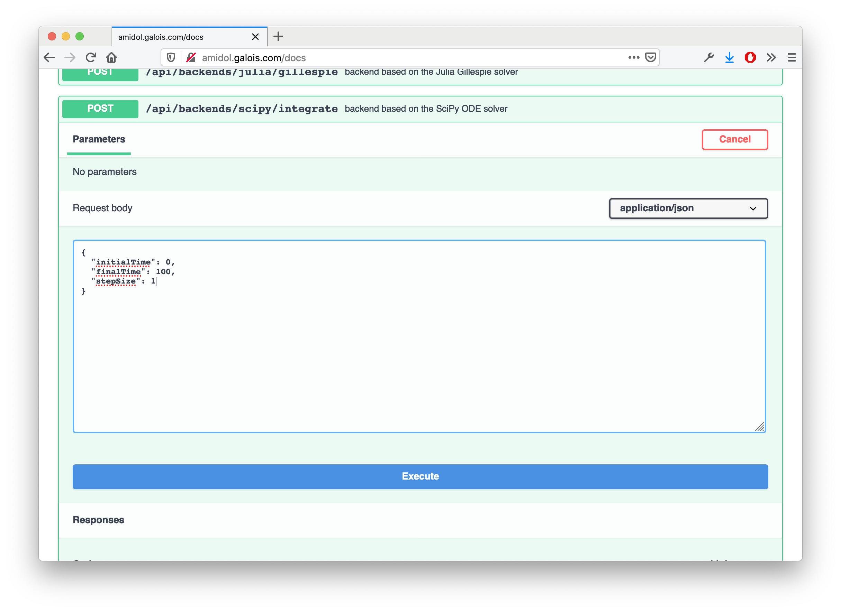
AMIDOL as a Service
AMIDOL’s code synthesis engine, and execution engine can be called remotely with custom parameters.
Allows AMIDOL to drive analytics, web pages, and other pages, analytics, and communications.

Slide 32
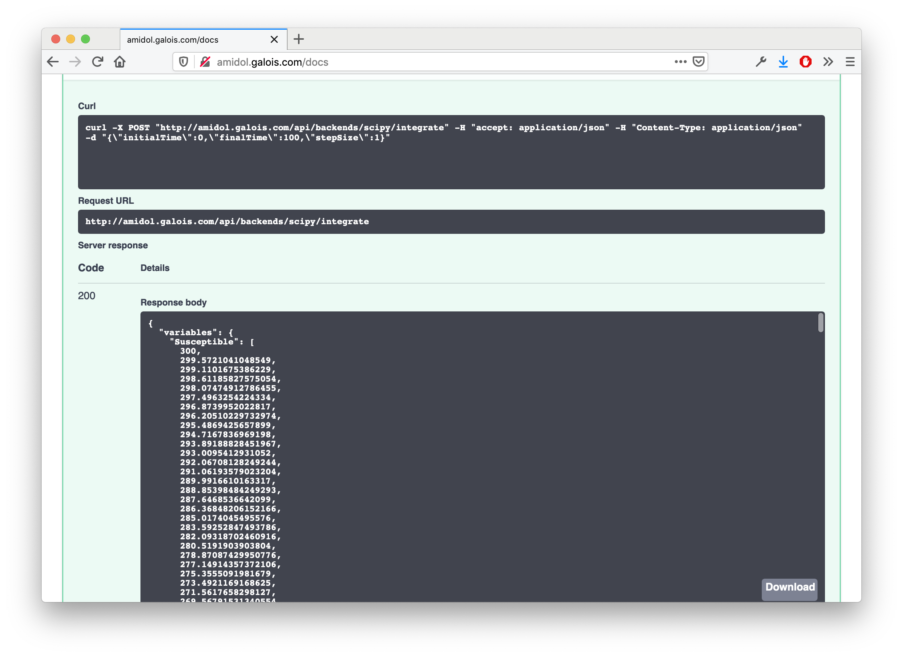
AMIDOL as a Service
Results of execution are exported by AaaS, and can then be loaded by web applications, remote systems, or ingested as “Data as a first class model”.

Slide 33
Near-term and Mid-term Vision

Slide 34
Developing AMIDOL During a Crisis
Near-term targets for AMIDOL
Rapid model validation and specialization workflows.
Data as first class models interface.
User-focused workflows for understanding data typing, and data as interfaces.
Rapid pipeline repair tools, and pipeline System Health Monitoring (SHM)
Model catalogue and model SHM.

Slide 35
Developing AMIDOL During a Crisis
Near-term targets for AMIDOL
Exposing collaborative model catalogues.
Interface with Git repos of models and data.
Intermediate representation of pipelines as composition.

Slide 36
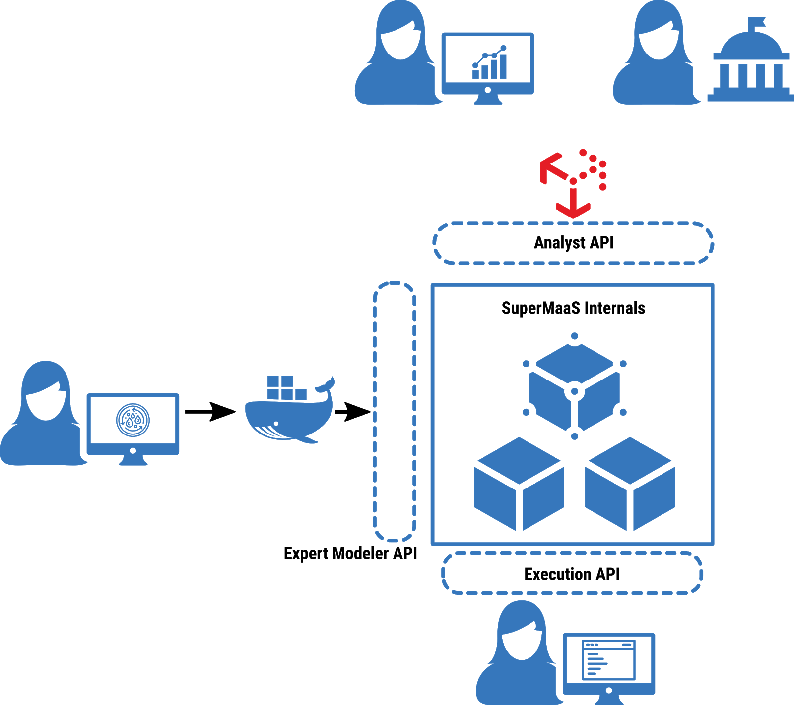
Developing AMIDOL During a Crisis
Mid-term targets for AMIDOL
Integrating AMIDOL to MaaS ecosystem as a model factory.
DataCubes and standardized output formats.

Slide 37

Thank you! Questions? http://amidol.galois.com https://github.com/GaloisInc/AMIDOL/ ewdavis@galois.com
Notes:
Leaders in high assurance research and development
Creating trustworthiness in critical systems
Solving your hardest computer science problems

